Slide 1


The IBM Cell Processor – Architecture and On-Chip Communication Interconnect

Slide 2
References
[1] Kewin Krewell. "CELL MOVES INTO THE LIMELIGHT". Microprocessor {2/14/05-01}
[2] Michael Kistler, Michael Perrone,Fabrizio Petrini. "CELL MULTIPROCESSOR COMMUNICATION NETWORK: BUILT FOR SPEED". In IEEE Micro, 26(3), May/June 2006
[3] Cell Broadband Engine resource center. http://www-128.ibm.com/developerworks/power/cell/
[4] H. Peter Hofstee. “Introduction to Cell Broadband Engine”
Notes:
The first paper left some concepts hazy

Slide 3

Agenda
Performance highlights of Cell
Real time enhancements
Target applications
Paper I (Cell Moves Into Limelight)
Paper II (Cell Multiprocessor Communication Network)
Cell Performance Overview
Programming Model
Power Management
Drawbacks

Slide 4
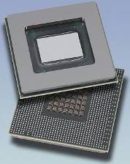
Performance Highlights of Cell
Delivers 204.8 GFlop/s single precision & 14.6Gflop/s double precision floating point performance
Supports virtualization, large pages from the Power architecture
Aggregate memory bandwidth of 25.6 GB/s at 3.2GHz
Configurable I/O interface capable of (raw) bandwidth of up to 25GB/s inbound & 35GB/s outbound
EIB supports peak bandwidth of 204.8GB/s
Extensible timers and counters to manage real-time response of the system
Notes:
Some exciting facts

Slide 5
Real Time Enhancements
Resource Reservation system for reserving bandwidth on shared units such as system memory, I/O interfaces
L2 Cache Locking system based on Effective or Real Address ranges
  Supports both locking for Streaming, and locking for High Reuse
TLB Locking system based on Effective or Real Address ranges or DMA class.
Fully pre-emptible context switching capability for each SPE
Privileged Attention Event to SPE for use in contractual light weight context switching
Multiple concurrent large page support in the PPE and SPE to minimize real-time impact due to TLB misses
Up to 4 service classes (software controlled) for DMA commands (improves parallelism)
Large page I/O Translation facility for I/O devices, graphics subsystems, etc - minimizes I/O translation cache misses
SPE Event Handling facilities for high priority task notification
PPE SMT Thread priority controls for Low, Medium and High Priority Instruction dispatch

Slide 6
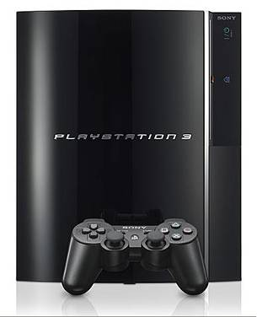
Target Applications
Advanced visualization
  Ray tracing
  Ray casting
  Volume rendering
Streaming applications
  Media encoders and decoders
  Streaming encryption and decryption
Fast Fourier Transforms (single precision)
E.g. Sony Play station 3
Scientific and parallel applications in general

Slide 7
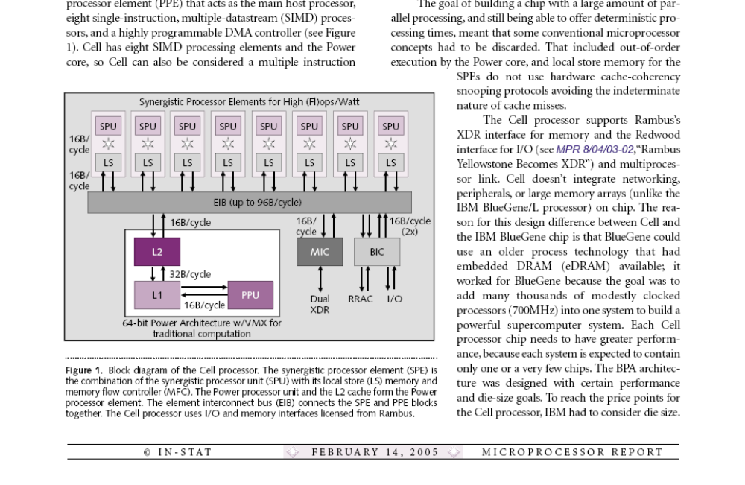
CBE Architecture
Block Diagram of Cell Processor

Slide 8
CBE Architecture - Overview
64bit Power architecture forms the foundation
Dual thread Power Processor Element (PPE)
Eight Synergistic Processor Elements (SPEs)
On-chip Rambus XDR controller with support for two banks of Rambus XDR memory
Cell processor production die has 235m transistors and is 235mm²
Cell doesn’t include networking peripherals or large memory arrays on chip
Reaches high performance due to high clock speed and high-performance XDR DRAM interface

Slide 9
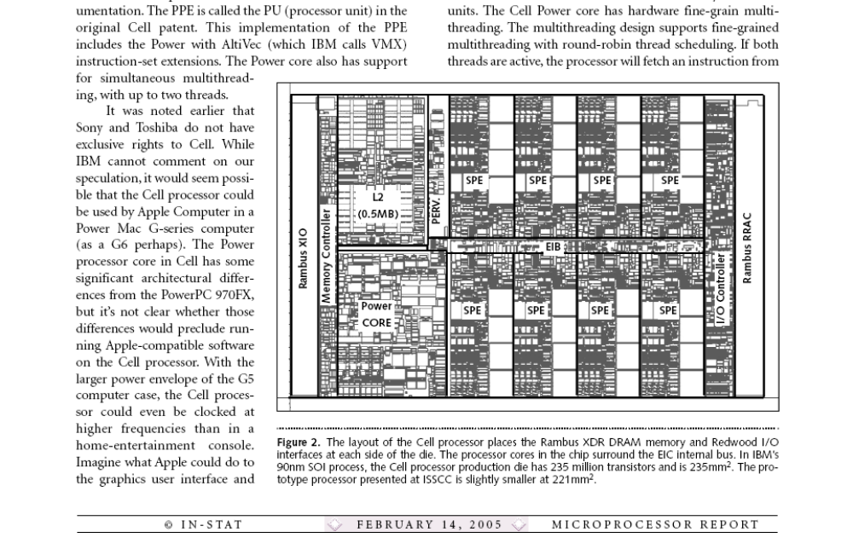
CBE Architecture – Chip Layout

Slide 10
CBE Architecture – Power Core
In-order two issue superscalar design
21 clock cycle long pipeline
Support for simultaneous (up to 2) multithreading
  Round robin scheduling
  Duplicated register files, program counters and parallel instruction buffers (before decode stage)
512K on-chip L2 cache
A mis-predicted branch – 8 cycle penalty
Load – 4 cycle data-cache access time
Big-endian processor

Slide 11
CBE Architecture – SPEs
SIMD-RISC instruction set
128-entry 128 bit unified register file for all data types
4 way SIMD capability - optional
“Branch hint” instructions instead of branch prediction logic in hardware – Software controlled branch prediction
Can complete up to two instructions per cycle
Can perform load, store, shuffle, channel or branch operation in parallel with a computation
Not multi-threaded
  Avoid miss penalty by having all data present all the time
  Reduce complexity in scheduling and die area requirement

Slide 12
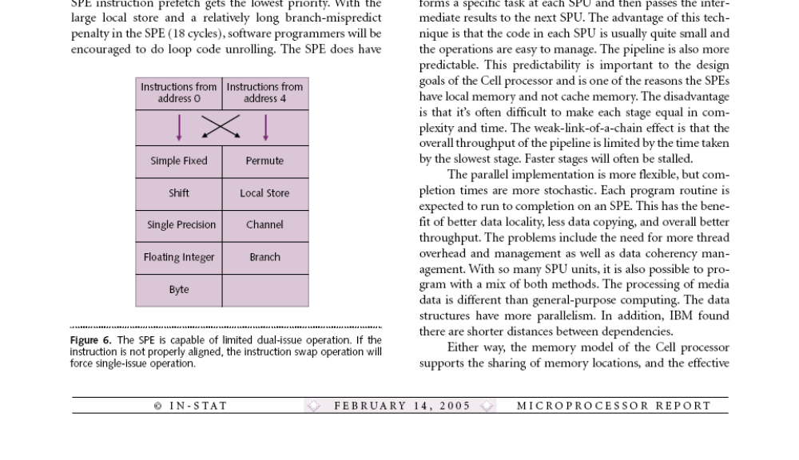
CBE Architecture – SPEs [2]
SPE is capable of limited dual issue operation
Improper alignment of instruction causes a swap operation forcing single-issue operation

Slide 13
CBE Architecture – Memory Model
Power core
  32K 2-way instruction cache and 32 K 4-way set associative data cache
256KB local store on SPE, 6 cycle load latency
  Software must manage data in and out of local store
  Controlled by the memory flow controller
  Does not participate in hardware cache coherency
  Aliased in the memory map of the processor
PPE can load and store from a memory location mapped to the local store (slow)
SPE can use the DMA controller to move data to its own or other SPEs local store & between local store and main memory as well as I/O interfaces
Memory flow controller on SPE can begin to transfer the data set of the next task as present one is running – Double Buffering

Slide 14
CBE Architecture – Memory Model [2]
Only quad-word transfers from the SPE local store
  Single ported
DMA transfers support 1024-bit transfers with quad word enables
Local store supports both a wide 128byte and a narrow 16byte access
DMA reads occupy single cycle for 128bytes
Access to local store is prioritized
  DMA transfers of PPE transfers occupy highest priority
  SPE loads and stores occupy second highest priority
  SPE instruction prefetch gets lowest priority
Conflict

Slide 15
Memory Flow Controller (MFC)
Local to each SPU, connects it to EIB
  SPU ←→MFC via SPU channel interface
  Separate read/write channels with blocking and non-blocking semantics
MFC runs at the same frequency as EIB
Accepts and processes DMA commands issued by SPU/PPE using the channel interface or memory mapped I/O (MMIO) registers asynchronously
Supports naturally aligned transfers of 1,2,4, or 8bytes or a multiple of 16bytes to a max of 16KB
DMA list – up to 2048 DMA transfers using single MFC DMA command

Slide 16
CBE Architecture – Communication
Element Interconnect Bus
  A data-ring structure with a control bus
  Each ring is 16B wide and runs at half of core clock frequency allowing 3 concurrent data transfers as long as their paths don’t overlap
  Four unidirectional rings, two running in each direction
    Implies worst case latency of only half the distance of the ring
  Manages token transactions
  Separate communication path for command and data
  Each bus element connected through a p2p link to the address concentrator
  Arbiter takes care of scheduling transfer ensuring no interference with in-flight transactions, gives priority to MFC and rest round robin

Slide 17
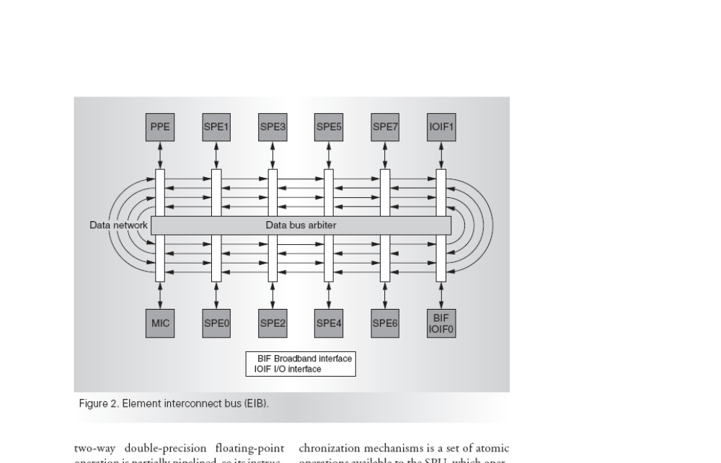
CBE Architecture – Communication [2]
Element Interconnect Bus

Slide 18
CBE Architecture – Communication [3]
I/O can be configured as two logical interfaces
MMIO for easy access of I/O from PPE and SPE
Interrupts from SPE and memory flow controller events are treated as external interrupts to PPE
Two cell processors can be connected via IOIF0 to form one coherent Cell domain using BIF protocol
Signal notification - two channels
Mailboxes – 32 bit communication channel between PPE and SPE
  Four entry, read blocking inbound
  Two single entry, write blocking outbound
Special operations to support synchronization mechanism

Slide 19
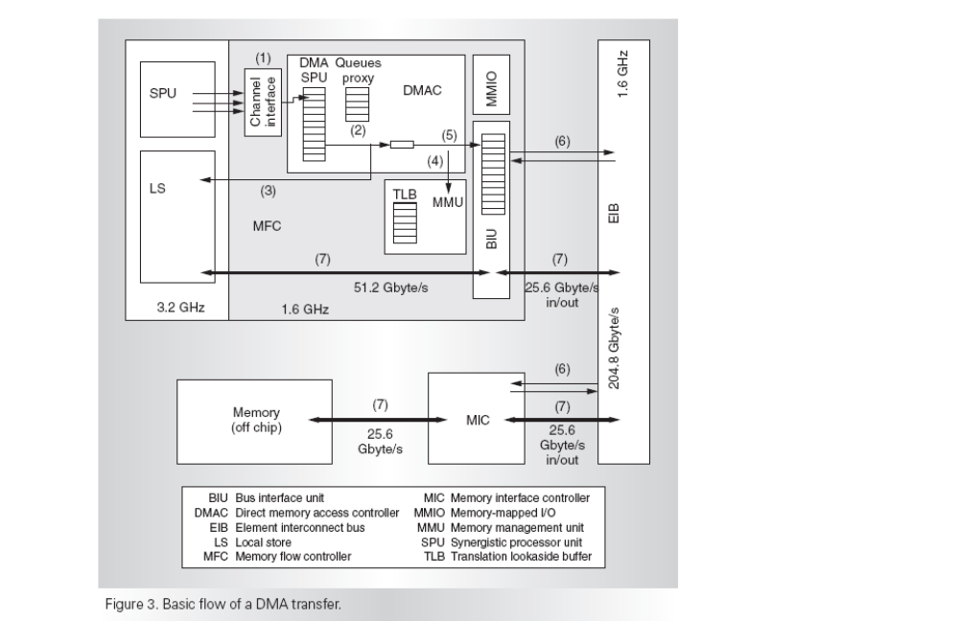
CBE Architecture – DMA
Basic Flow of a DMA transfer

Slide 20
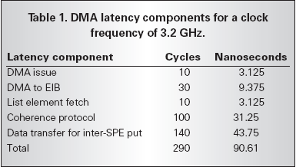
DMA Latency

Slide 21
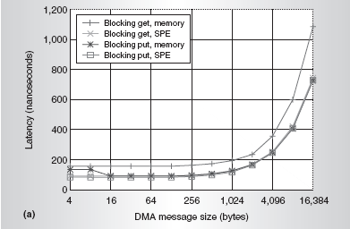
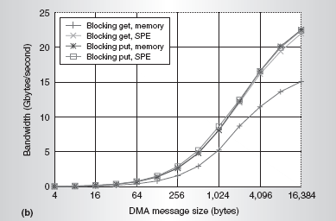
Interconnect Performance
Latency and bandwidth against DMA message size in the absence of contention

Slide 22
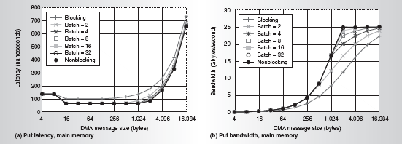
Interconnect Performance [2]

Slide 23
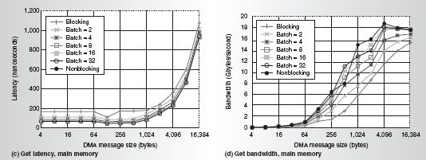
Interconnect Performance [3]

Slide 24
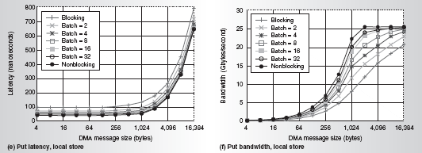
Interconnect Performance [4]

Slide 25
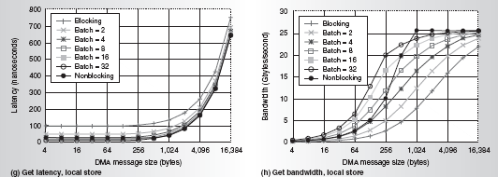
Interconnect Performance [5]

Slide 26
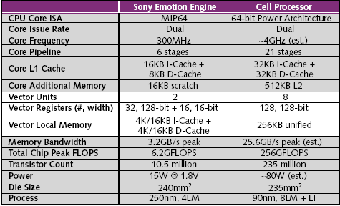
Cell vs. Sony Emotion Engine

Slide 27
CBE Programming
Tool chain for Cell built on PowerPC Linux
Programming of SPE based on C with limited C++ support
Debugging tools include extensions for P-Trance and extended GNU debugger (GDB)
Programming Models:
  Pipeline model
  Parallel model
  Combination of the two

Slide 28
Power Management
Capable of being clocked at one-eighth the normal speed when idling
Multiple power management states available to privileged software
  Active, slow, pause, state retained and isolated (SRI), state lost and isolated (SLI)
  Each progressively more aggressive in saving power
  Software controls the transitions, but can be linked to external events
  SLI state – the device is effectively shut off from the system

Slide 29
Drawbacks
Full SPE context switch is relatively expensive
  This can negatively affect virtualization of SPEs if not properly handled
This instantiation of Cell – not suitable for DP math
  No support for IEEE 754 precise mode
  Use by super computer applications will require further development

